Slide 1

Best Neighborhoods in Pittsburgh
Team Data Thieves
David Roberts, Mason Dill, Yuanheng Qu

Slide 2
Our Metric for Rating Neighborhoods
For crimes per person per neighborhood:
The percentage of crimes per person will be multiplied by 1000
Ex: A neighborhood with 0.068 crimes per person will get 68 points.
For each type of crimes in each neighborhood:
Drug and property crimes: 2 points per incident
Violent crimes: 4 points per incident
Sexual crimes: 8 points per incident
For incidents of fire in each neighborhood:
3 points
THE LESS POINTS, THE BETTER THE NEIGHBORHOOD

Slide 3
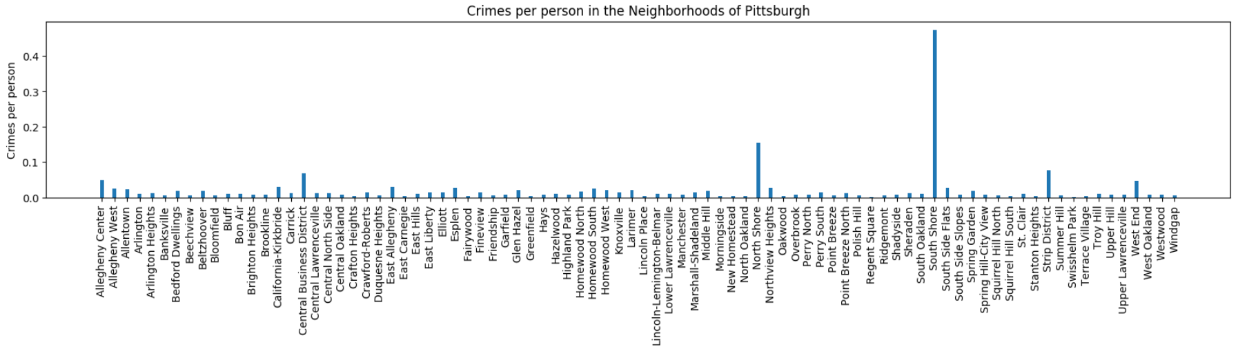
Part 1: Number of Crimes per Person per Neighborhood
3000+ crimes in Pittsburgh in the last 30 days
80+ neighborhoods in Pittsburgh
Which one has the lowest crime per person?

Slide 4


Step 1: Load CSV’s into Dictionaries
Crime Csv
Population Csv

Slide 5

Step 2: Calculate Crimes per Person

Slide 6

Step 3: Create and Display a Graph

Slide 7
Conclusion:
Worst Neighborhoods
Best Neighborhoods
South Shore: 474 points
North Shore: 155 points
Strip District: 76 points
Regent Square: 2 points
Swisshelm Park: 2 points
Crafton Heights: 3 points

Slide 8
Part 2: Different Types of Crimes
Property Crimes
Drug Crimes
Violent
Sexual Crimes

Slide 9
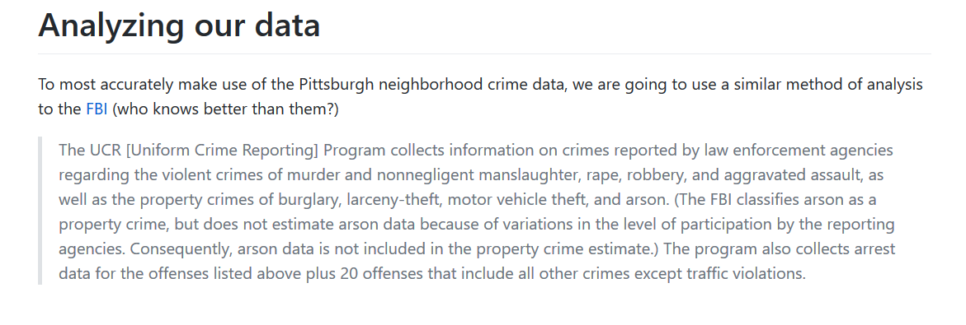

Slide 10
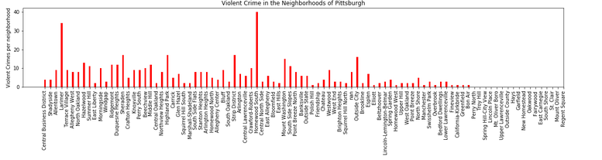

Slide 11
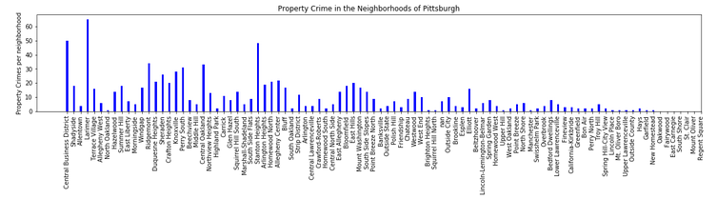

Slide 12
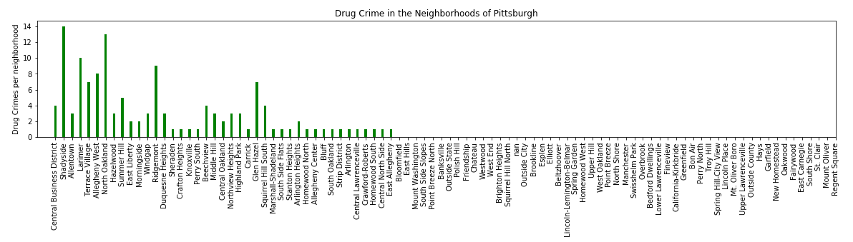

Slide 13
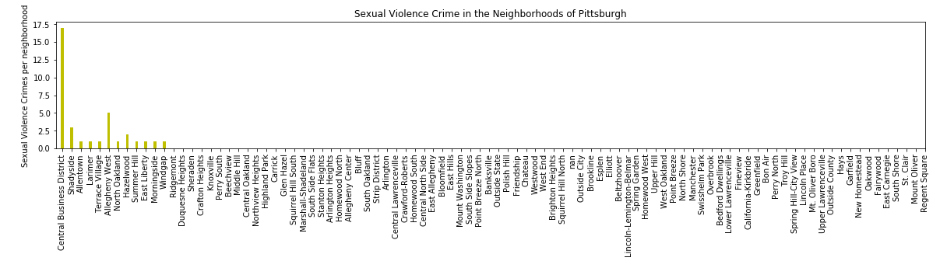

Slide 14
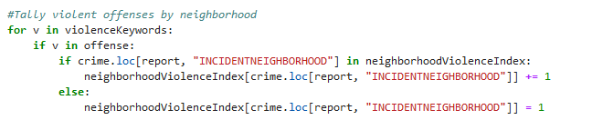
Our Filtering technique
When referencing the Pittsburgh WPRDC police dataset, these are the keywords associated for broad category crimes we are scanning for. Every incident report is given a category and incident report. These keywords appear in the category. Inevitably, some incidents will slip through the cracks

Slide 15
Conclusion:
Worst Neighborhoods
Best Neighborhoods
South Shore: 478 points
Central Business District: 198 points
North Shore: 171 points
Swisshelm Park: 2 points
East Carnegie: 4 points
Regent Square: 4 points

Slide 16
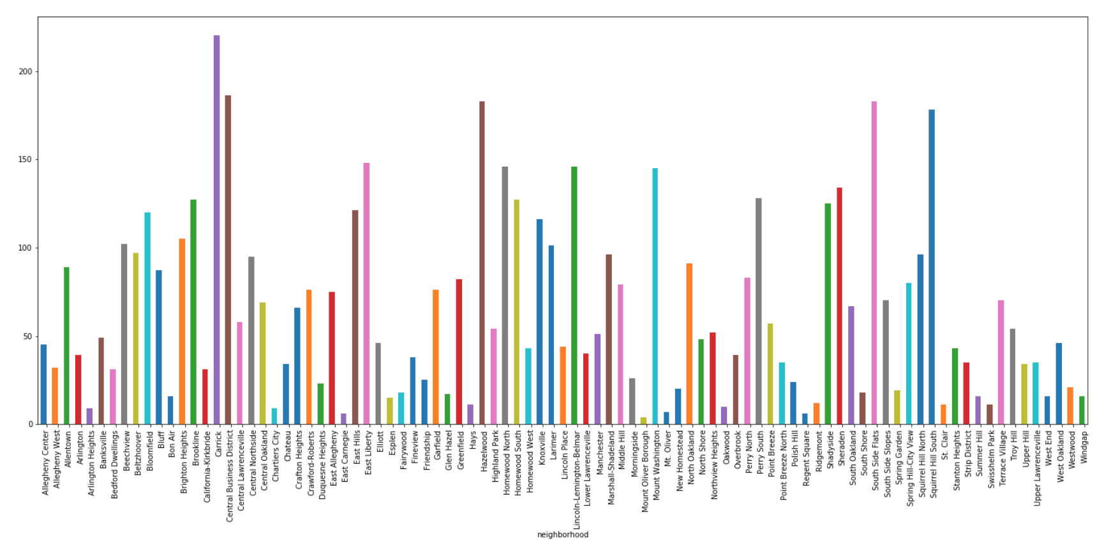
Part 3: Number of Fire Incidents per Neighborhood

Slide 17
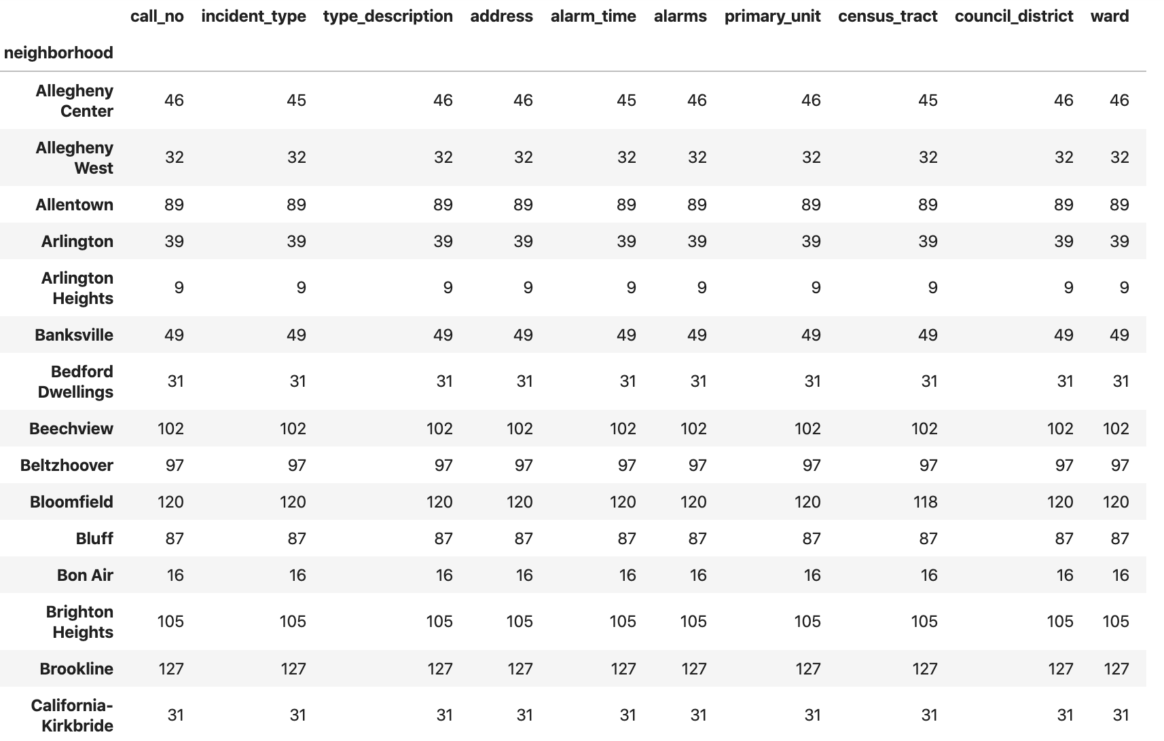
Step 1: Load the CSV and COUNT!!!

Slide 18
Step 2 : Plot the Graph

Slide 19
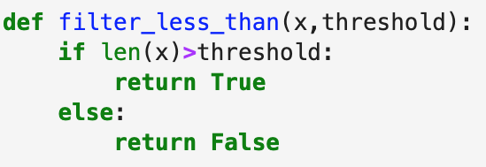
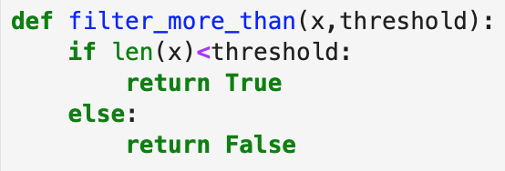
Step 3: Create the Filters

Slide 20
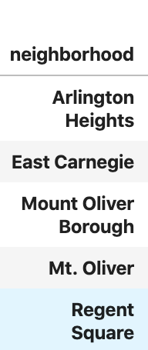
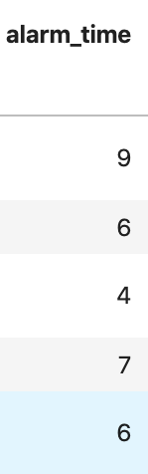
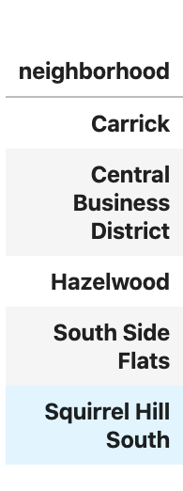
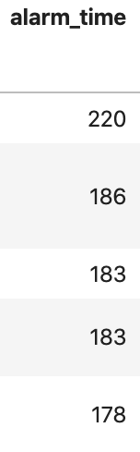
Step 4: Find the Best and the Worst
Poorest: Best:

Slide 21
Conclusion:
Worst Neighborhoods
Best Neighborhoods
Central Business District: 756 points
Carrick: 743 points
South Side Flats: 674 points
East Carnegie: 22 points
Regent Square: 22 points
Mount Oliver: 31 points

Slide 22
Thank You! Any Questions?
Our GitHub: https://tinyurl.com/DataTheivesGitHub

